Slide 1
Interprocess Communication IPC
Shared Memory

Slide 2
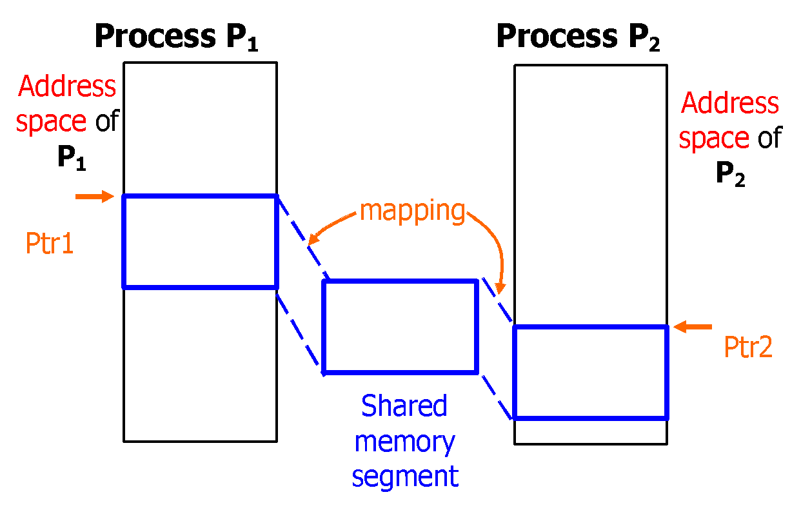
Shared Memory Concept
Key 123
(System wide info)

Slide 3
How to Create Shared Memory
One of the processes creates a shared segment. Other processes get ID of the created segment
Each process, using the same key, attaches to itself the created shared segment
Now each process may write and read data into the shared segment
Each process detaches the segment (after finishing)

Slide 4
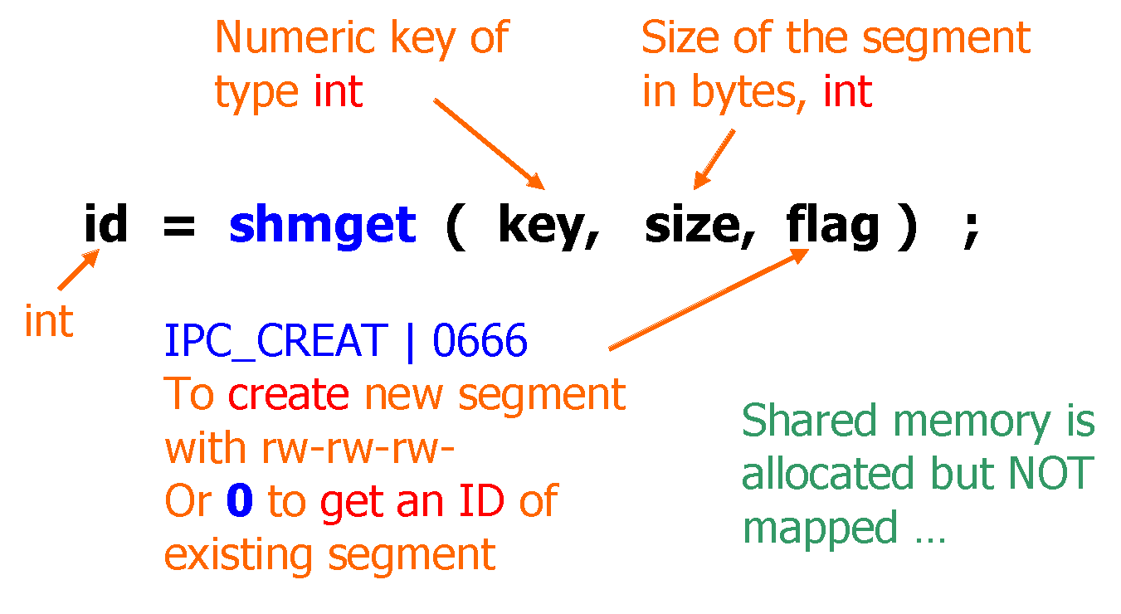
System Calls for Shared Memory
#include <sys/types.h>
#include <sys/ipc.h>
#include <sys/shm.h>
1. Creating a shared segment or getting its ID

Slide 5
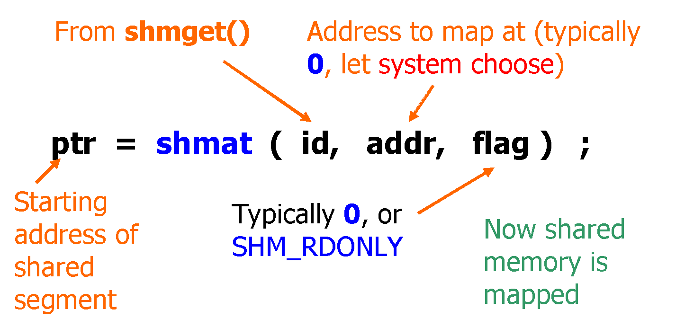
System Calls for Shared Memory
2. Attaching (mapping) the existing memory segment (getting its pointer).

Slide 6
Typedef struct shmid_ds{
struct ipc_perm shm_perm; /* operation permission
structure */
size_t shm_segsz; /* size of segment in bytes */
pid_t shm_lpid; /* process ID of last operation */
pid_t shm_cpid; /* process ID of creator */
shmatt_t shm_nattch; /* number of current attaches */
time_t shm_atime; /* time of last shmat */
time_t shm_dtime; /* time of last shmdt */
time_t shm_ctime; /* time of last shctl */
} shmid_ds

Slide 7
Example
/* Header file line.h */
struct info {
char c;
int length;
};
#define key ((key_t)(key = 1243));
#define MSIZ sizeof(struct info)

Slide 8
Example
Process A
Process B
#include <stdio.h>
#include <stdlib.h>
#include <sys/types.h>
#include <sys/ipc.h>
#include <sys/shm.h>
#include <unistd.h>
#include "line.h"
main(void)
{
int i, id ;
struct info *ctrl;
if ( (id = shmget( key,MSIZ,IPC_CREAT | 0666) ) < 0 )
{
printf("error 1\n");
exit(1) ;
}
if ( (ctrl = (struct info *) shmat( id, 0, 0)) <= (struct info *) (0) )
{
printf("error 2\n");
exit(1) ;
}
#include <stdio.h>
#include <stdlib.h>
#include <sys/types.h>
#include <sys/ipc.h>
#include <sys/shm.h>
#include "line.h"
main(int argc, char *argv[])
{
int id ;
struct info *ctrl;
if (argc < 3)
{
exit(3);
}
if ( (id = shmget( key,MSIZ, 0 )) < 0 )
{
exit(1) ;
}
ctrl = (struct info *) shmat( id, 0, 0);
if ( ctrl <= (struct info *) (0) )
{
exit(1) ;
}

Slide 9
Example
Process A
Process B
ctrl->c = 'a';
ctrl->length = 10;
// print line every 4 seconds
for (i = 0 ; i <ctrl->length ; i++ )
{
putchar (ctrl->c);
putchar ('\n');
sleep(4);
}
//now detach the pointer from the shared memory
shmdt(ctrl);
//let us delete the shared memory
shmctl(id,IPC_RMID,NULL);
//job done
}
ctrl->c = argv[1][0] ;
ctrl->length = atoi(argv[2]);
//detach the pointer from the shared memory
shmdt(ctrl);
exit(0);
}

Slide 10
Example 2
Header
struct info {
char c;
int length;
char flag;
};
key_t key = 1243 ;
#define MSIZ sizeof(struct info)

Slide 11
Example 2
Process C
Process D
#include <stdio.h>
#include <stdlib.h>
#include <sys/types.h>
#include <sys/ipc.h>
#include <sys/shm.h>
#include "header.h"
main(void)
{
int i, id ;
struct info *ctrl;
if ( (id = shmget( key,MSIZ,IPC_CREAT | 0666) ) < 0 )
{
printf("error 1\n");
exit(1) ;
}
if ( (ctrl = (struct info *) shmat( id, 0, 0)) <= (struct info *) (0) ) {
printf("error 2\n");
exit(1) ;
}
ctrl->c = 'a';
ctrl->length = 10;
ctrl->flag = 0;
#include <stdio.h>
#include <stdlib.h>
#include <sys/types.h>
#include <sys/ipc.h>
#include <sys/shm.h>
#include "header.h"
main(int argc, char *argv[])
{
int id ;
struct info *ctrl;
if (argc < 3)
{
exit(3);
}
if ( (id = shmget( key,MSIZ, 0 )) < 0 )
{
exit(1) ;
}
ctrl = (struct info *) shmat( id, 0, 0);
if ( ctrl <= (struct info *) (0) )
{
exit(1) ;
}
// wait until Process C is ready to receive from process D
while(ctrl->flag==0);

Slide 12
Example 2
Process C
Process D
for (i = 0 ; i <ctrl->length ; i++ )
{
putchar (ctrl->c);
putchar (' ');
}
putchar('\n');
fflush(stdout);
ctrl->flag = 2;
while(ctrl->flag!=1);
// print the character ctrl->c for ctrl->length times in a single line
for (i = 0 ; i <ctrl->length ; i++ )
{
putchar (ctrl->c);
putchar (' ');
}
putchar ('\n');
// flushing stdout just in case
fflush(stdout);
//now detach the pointer from the shared memory
shmdt(ctrl);
//let us delete the shared memory
shmctl(id,IPC_RMID,NULL);
//job done
}
/* copy command line data to shared memory */
ctrl->c = argv[1][0] ;
ctrl->length = atoi(argv[2]);
ctrl->flag = 1;
//detach the pointer from the shared memory
// .. we do not need to delete here, can be done in either of the process
shmdt(ctrl);
exit(0);
}

Slide 13
Shared Memory Features
Efficiency (no intermediate copying of data as in pipes)
Random access (a sequential byte stream in pipes)
Many-to-many mechanism of IPC: many processes may attach the same segment (pipes provide one-to-one mechanism of IPC)
No synchronization is provided (pipes provide synchronization)
Limitations on the number of shared memory segments:
Some of these can be changed by a system administrator, by configuring a new kernel. These limits are: maximum and minimum size in bytes; max no. of shared memory segments, system wide and per process.

